Slide 1
Airline Reservation System ‘Airtra’
Bishal Shrestha

Slide 2
Introduction
Airline reservation system is the computerized system.
Enhancing the relationship between customers and airline agencies.
Convenient for the customers to book the flights.
database and allow new customers to sign up for online access.
Allow the customers to access database and allow new customers to sign up for online access.

Slide 3
Goals
The primary goal of this project is to help the passengers to make easy and secure flight reservation.
The system will be able to find all the flights fulfilling a passengers needs for the require interval of time.
Search all flights with a given origin and destination.
The arrival and departure time, the price and the flight number for each flight.
The passenger will decide the flight reservation based on the displayed information.

Slide 4
Major Functions
Providing flight details.
Flights in accordance with round trip and single trip.
Flight booking for a particular destination
Payment can only be done with encrypted code generated.
Allowing the customer to modify or cancel his/her reservation provided the correct pin code is given.
Displaying a report of the number of people flying in a particular flight.

Slide 5
Modules
Administrative Module
User/Passenger Module
Registration Module
Cancellation Module
Payment Module(e-sewa virtual API)

Slide 6
Administrative module
It is provided for the sake of administrators to manage the site and update the contents at regular intervals.
Major Operations are:
View Balance, View reservation and cancellation details
View and work on flight details
Add admin and user
Add airport details

Slide 7
Registration Module
Firstly we ask passenger to give their details.
After registration process the passenger can logon to the system and can perform things like booking cancellation.
Once passenger registered with us can book any no. of tickets.

Slide 8
Passenger Module
It is meant for the passenger, where a user logging into their account will view this panel. The major operations included in this module are:
View the airline schedules, timings, fare details and seats availability.
Book tickets, view and cancelling tickets
Views history , can send feedbacks

Slide 9
Application
No geographical barriers; agents can book tickets from any location.
User-friendly graphically Interfaces helps to book tickets without knowing the specific modules of the GD Systems.
More sale of tickets brings more profits.

Slide 10
Payment Module
Here passenger can book the respective flights in accordance with their preferred flights.
They can use online wallet or direct cash to make payments
Payment can be done with E-sewa.

Slide 11
Objectives
Accuracy
Usability/ Informative
Efficiency
Effectiveness
Speed
User-friendliness
Reservation and cancellation of flighs from anywhere any place.

Slide 12
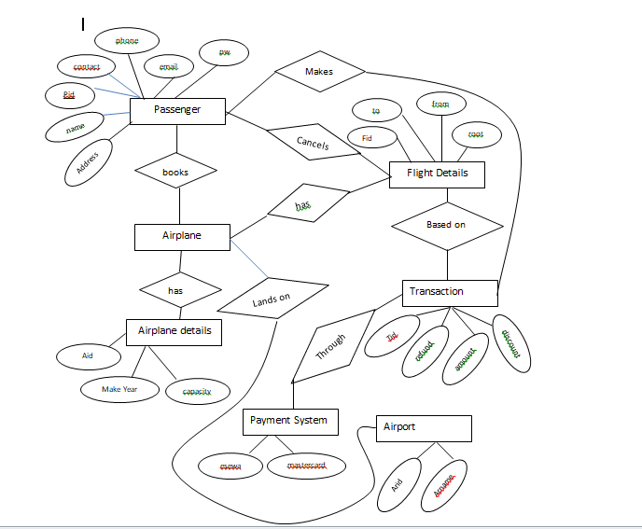

Slide 13
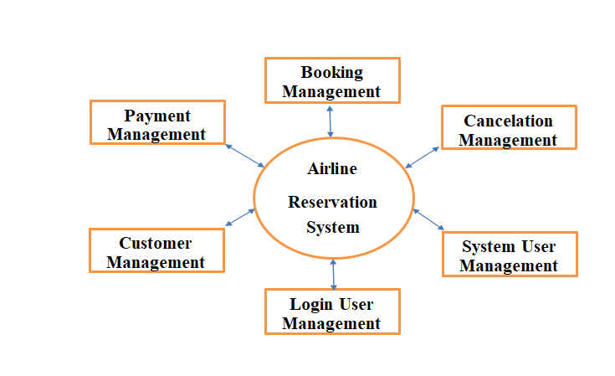

HELLO!
System Specific Diagram

Slide 14
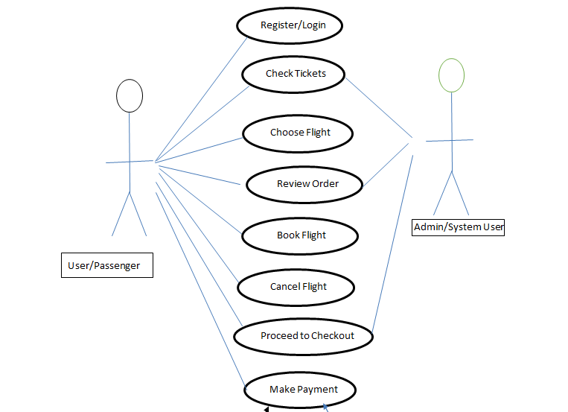
PRESENTATION DESIGN
Use case Diagram
You don’t need to keep this slide in your presentation. It’s only here to serve you as a design guide if you need to create new slides or download the fonts to edit the presentation in PowerPoint®

Slide 15
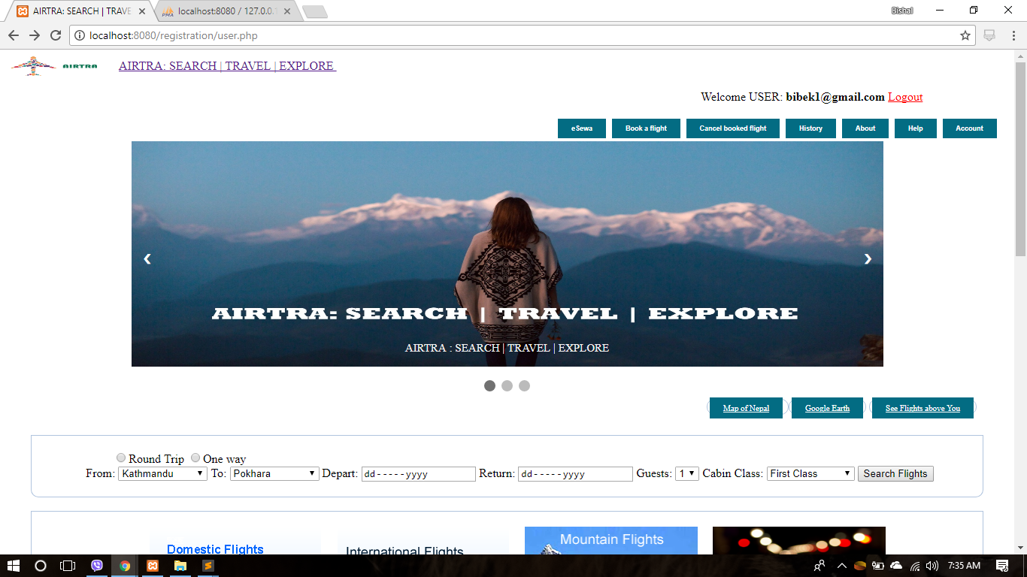
Screenshots

Slide 16
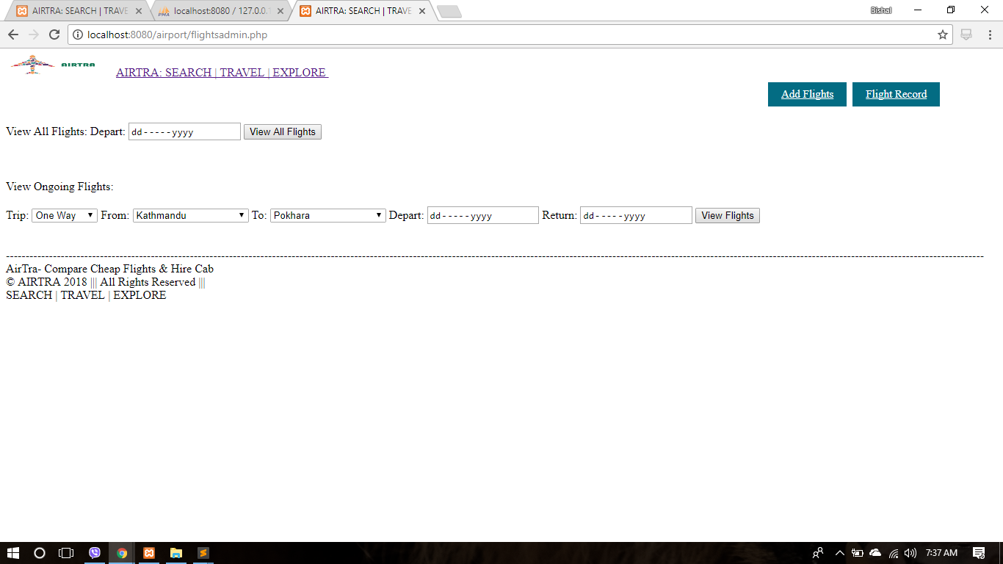

Slide 17
Advantages
Book a flight from anywhere anytime.
Changes and Cancellations as necessary.
The freedom to shop around for a best price, cost benefits.
Save a lot of time by a computerized GUI based system”AirTra”

Slide 18
Disadvantages
Exchanging sensitive personal data, such as home addresses and payment gateways, the online booking is an attractive target for cyber criminals looking to steal this information.
Fake websites created for the sole purpose of stealing personal information is also an ever-present danger.
Very normal people are unable to book a flight like live ticketing .

Slide 19
Conclusion
Airline Reservation System contains the details about flights schedules, passenger reservations and ticket records.
Inventory data is imported and maintained through a Schedule Distribution System over Standardized interfaces.
In combination with the fares and booking conditions stored in the Fare Quote System the price for each sold seat is determined.
The inventory of an airline service is generally divided into three category of classes.

Slide 20
Any questions?
You can find me at:
https://github.com/shrestha-bishal

Slide 21
Thank You

